Slide 1
Parking Space Counter Using OpenCV and Python
CSMSS
Chh. Shahu College of Engineering
Department of Computer Science & Engineering
Year 2022-23
Group Member :
1. Aatish Lahane (CS3264)
2. Divya Lavande (CS3273)
Guide name: Prof. A. S. Sardar

Slide 2
Contents
Introduction
Technologies and Library
Problem Definition in Details
System Analysis And Design
System Implementation
Conclusion and Future Scope
References

Slide 3
1. Introduction:
How many times has it happened to you that you are searching for a parking spot by driving around and around the parking lot. How convenient would it be if you know exactly where the closest parking spot is!
It turns out that this is a relatively easy problem to solve using Python and OpenCV. All that is needed is an aerial shot of the parking lot.
Growing in the technology make evolution in day to day life. Buy seeing towards the technology the human is going towards the automation, but at many places it is not affordable to there system. Coming to the point there should be the easy way to complete the work.
Taking one of the example as car parking system. It is just the solution to help to detect no of cars present in a parking to know how many empty slots are available for parking.
The search for a parking space in urban areas is often time-consuming and nerve-racking. Efficient car park guidance systems could support drivers in their search for an available parking space.
See GIF below where my model is highlighting all available parking spots in parking lot as well as displaying a count of how many spots are available. And best of all this can work real time!

Slide 4
2.Technologies & Libraries:
Technologies used:
A. Python 3.0
Python 3.0 final was released on December 3rd, 2008. The language is mostly the same, but many details, especially how built-in objects like dictionaries and strings work, have changed considerably, and a lot of deprecated features have finally been removed. Also, the standard library has been reorganized in a few prominent places.
B. CV2 Module
OpenCV-Python is a library of Python bindings designed to solve computer vision problems.
Syntax: cv2.VideoCapture(). cv2.VideoCapture() method load and save and read video.
Features of OpenCV Library
Using OpenCV library, you can −
Read and write images
Capture and save videos
Process images (filter, transform)
Perform feature detection
Detect specific objects such as faces, eyes, cars, in the videos or images.
Analyze the video, i.e., estimate the motion in it, subtract the background, and track objects in it.

Slide 5
3. Problem Definition in Details:
Car parking is a major problem in urban areas in both developed and developing countries.
Following the rapid incense of car ownership, many cities are suffering from lacking of car parking areas with imbalance between parking supply and demand which can be considered the initial reason for metropolis parking problems.
This imbalance is partially due to ineffective land use planning and miscalculations of space requirements during first stages of planning.
Shortage of parking space, high parking tariffs, and traffic congestion due to visitors in search for a parking place are only a few examples of everyday parking problems.

Slide 6
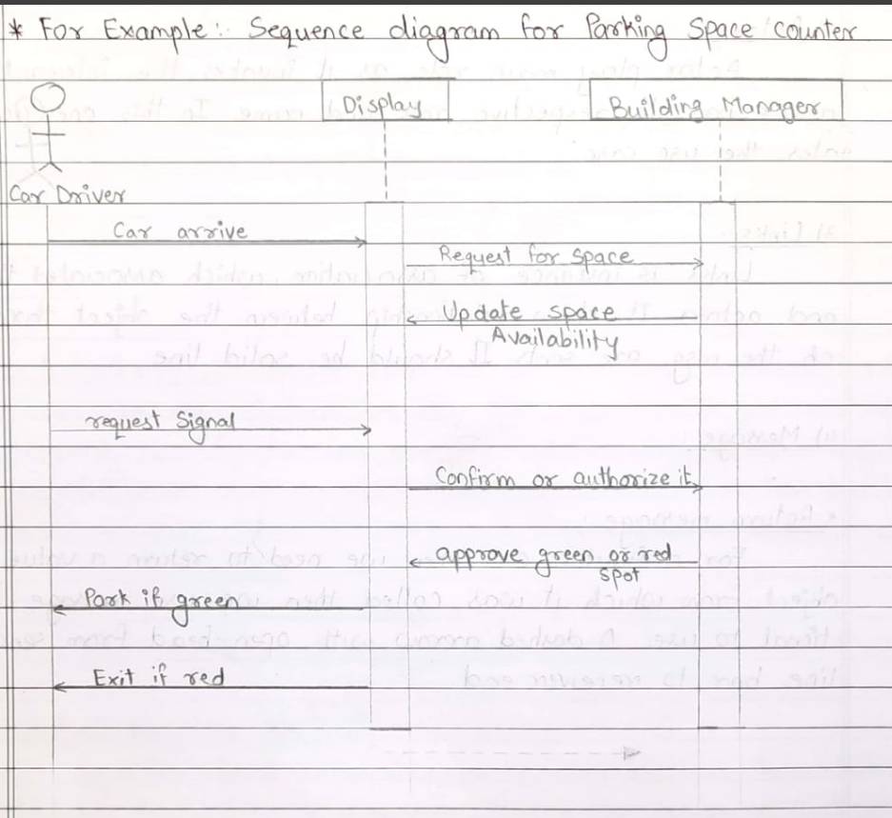
4. System Analysis and Design

Slide 7
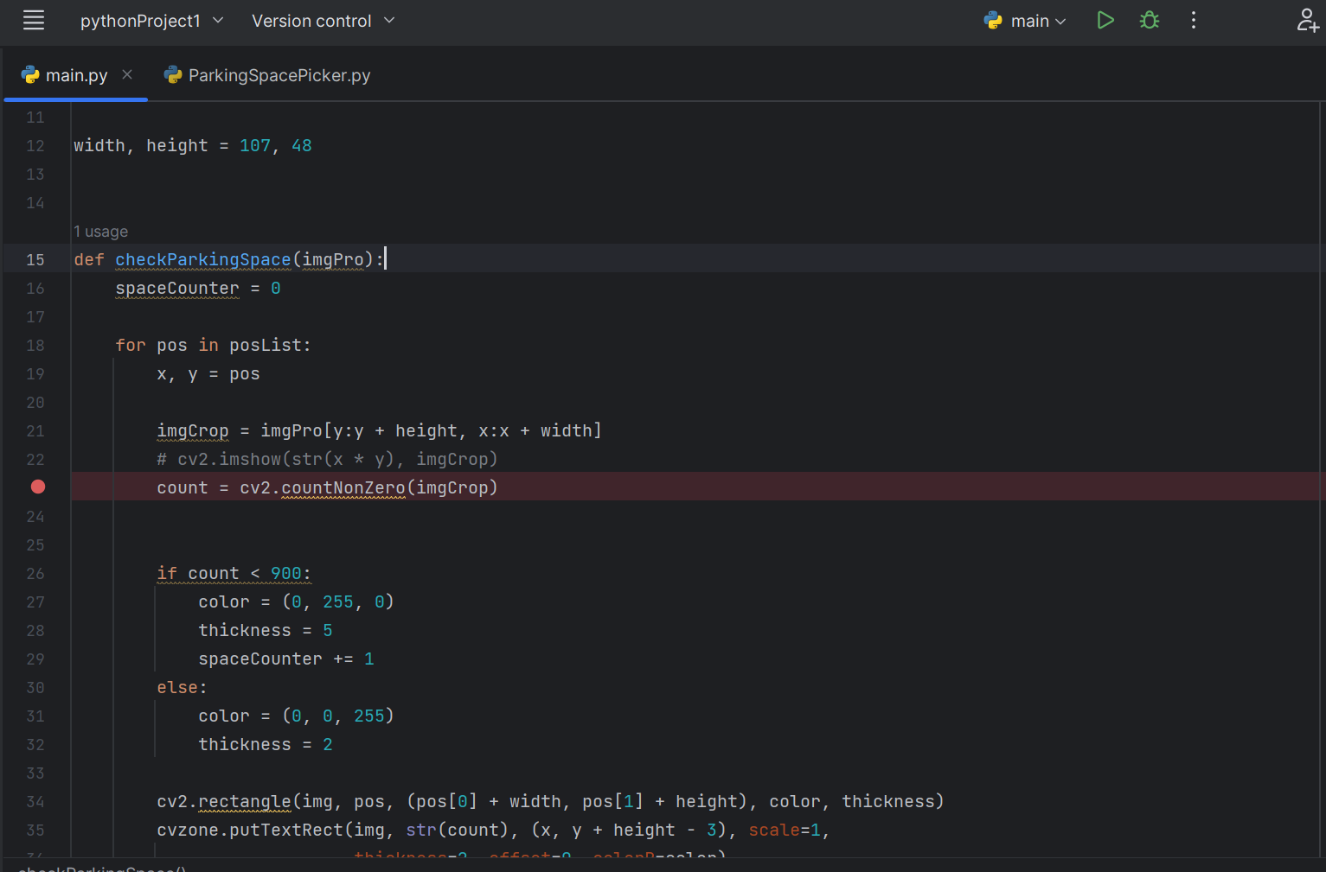
5. System Implementation Coding

Slide 8
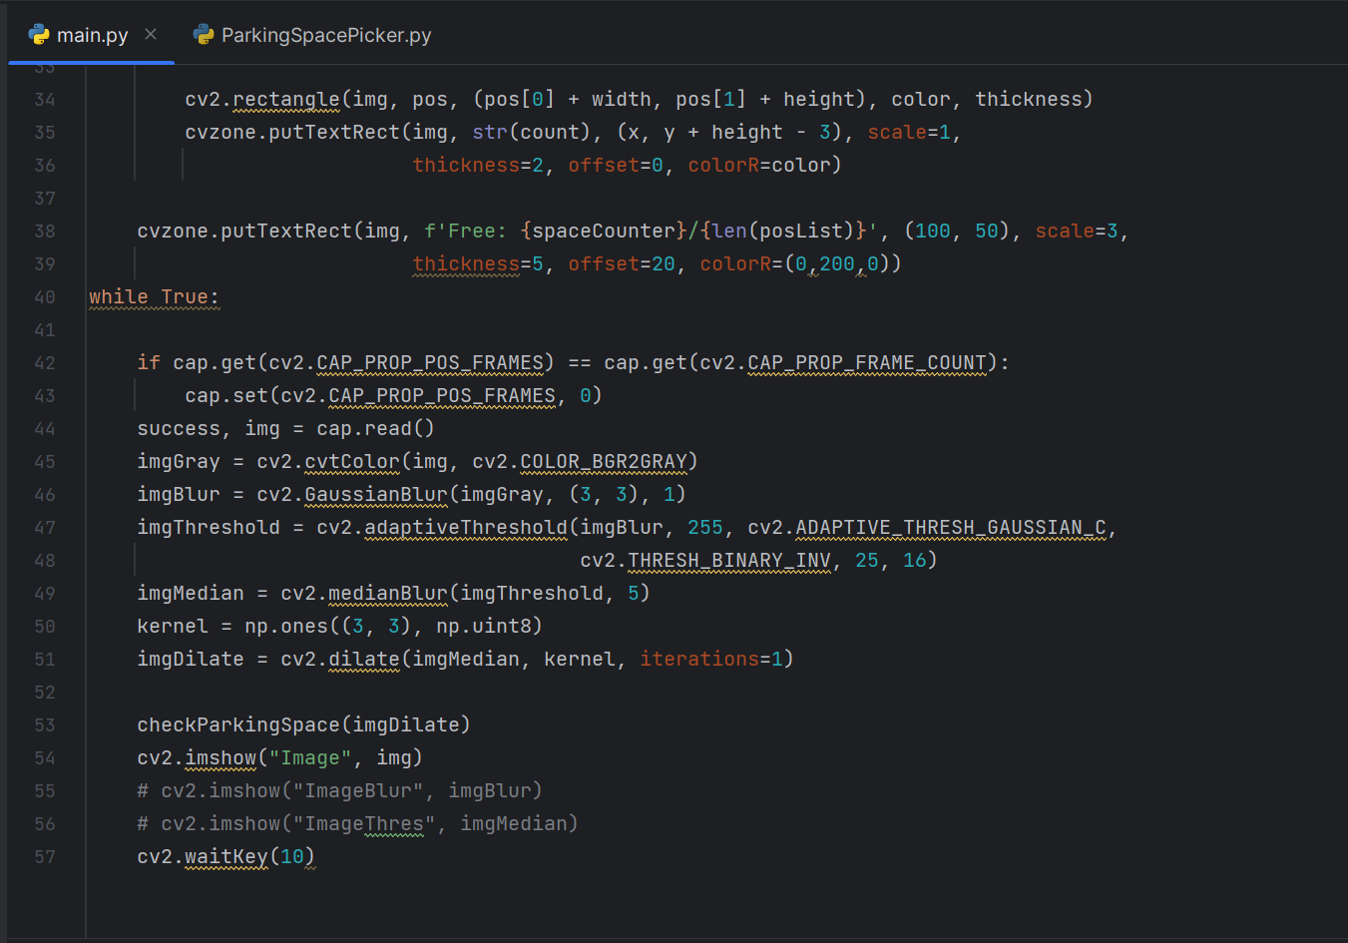

Slide 9
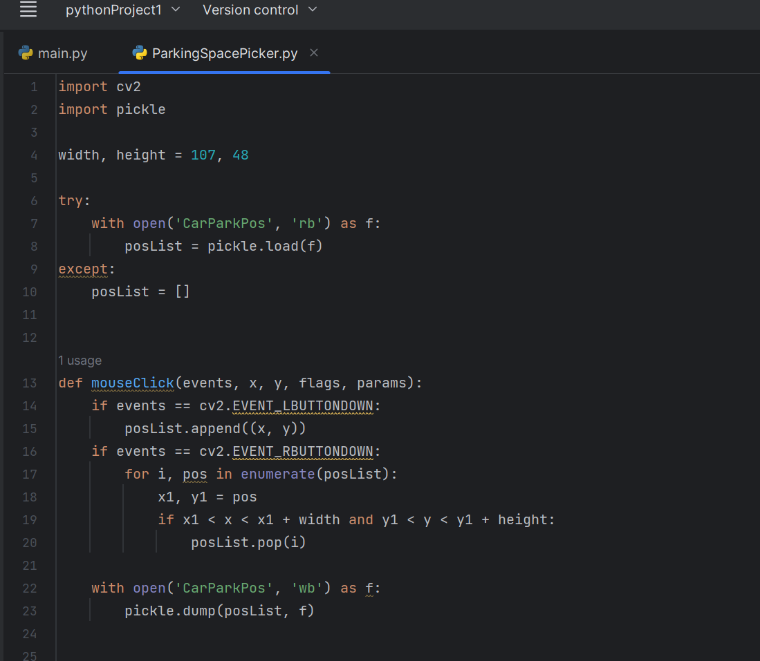

Slide 10
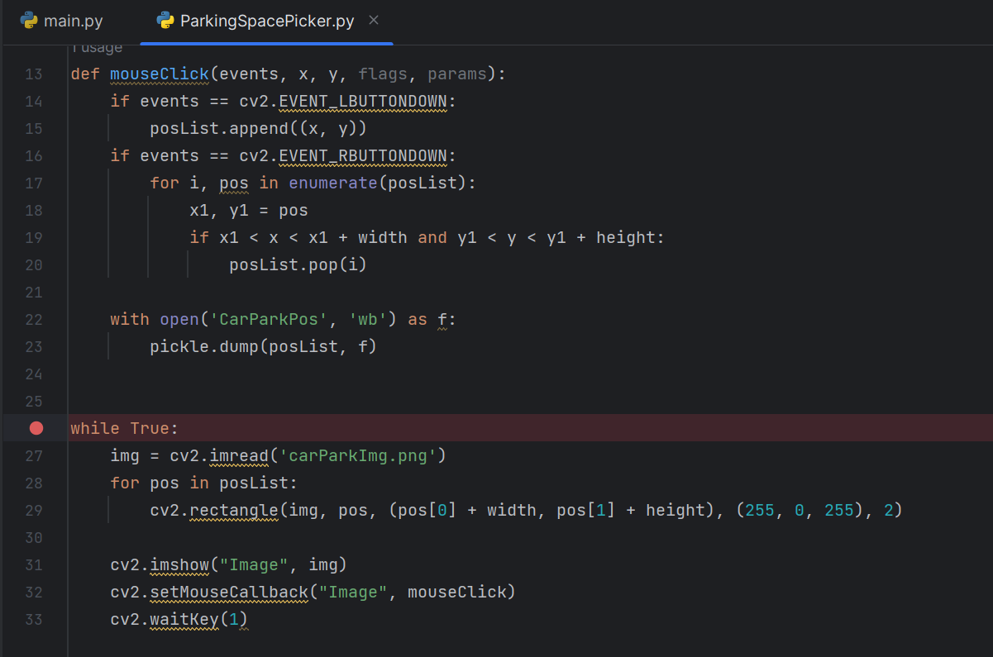

Slide 11
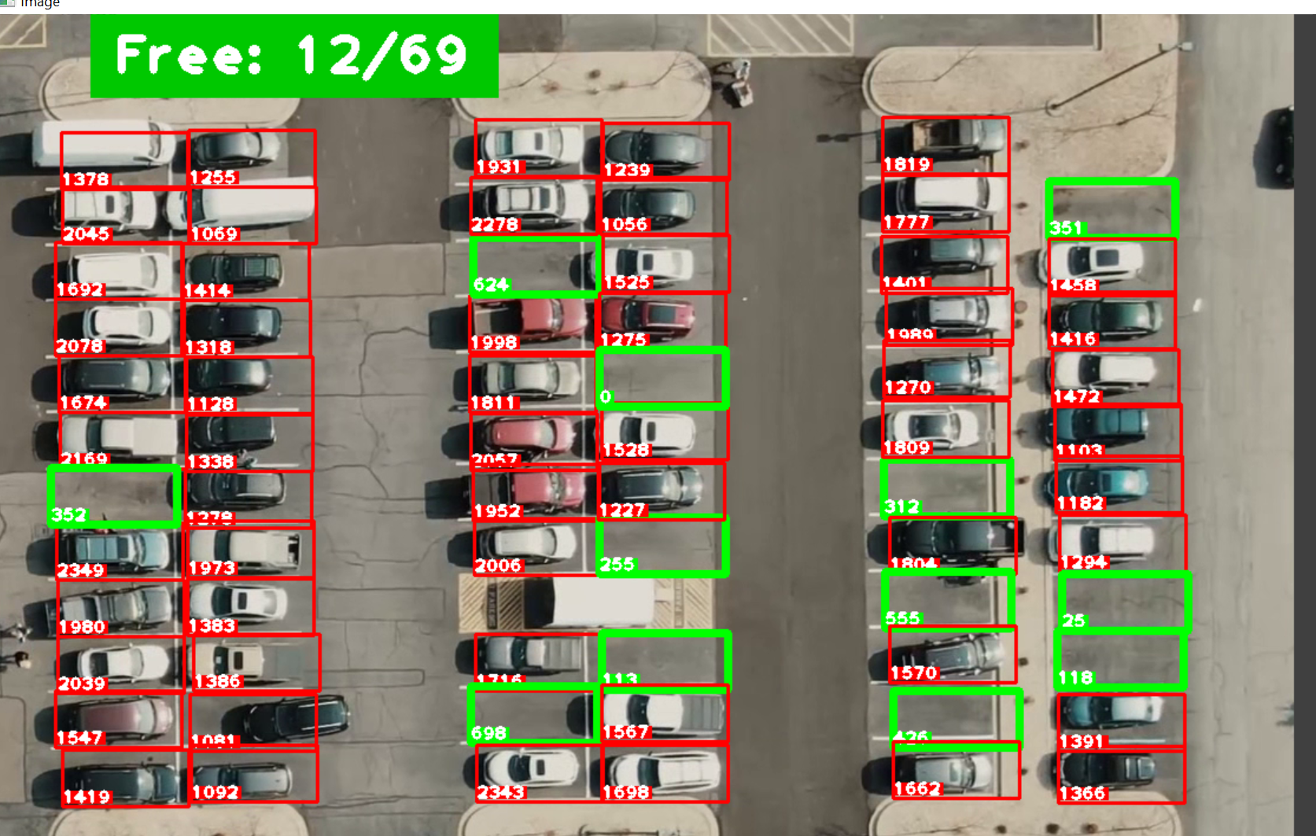
Fig.: Parking Spaces And Available Parking Spots

Slide 12
6. Conclusion and Future Scope:
A parking space counter is a device or system used to count the number of vehicles that enter and exit a parking lot. It can be used to monitor the occupancy of a parking lot and to help drivers find available spaces.
The conclusion for a parking space counter is that it is a useful tool for managing parking lots and improving the parking experience for drivers. It can also provide valuable data for parking lot owners and operators to make informed decisions about their facilities.
This system find parking slot and location to park a vehicle and help users to easy find parking.
In the future we making real time system and try to improve accuracy of the project.

Slide 13
7. References:
https://medium.com/swlh/build-a-simple-smart-parking-project-using-python-and-opencv-2bd891d05199
https://towardsdatascience.com/find-where-to-park-in-real-time-using-opencv-and-tensorflow-4307a4c3da03

Slide 14
THANK YOU

